Slide 1

HTTP/Web-Services-GET
M2-D11

Slide 2
Week 7 Overview
Monday
Networking Consuming Restful APIs HTTP GET
Tuesday
Consuming Restful APIS HTTP POST
Wednesday
Building Server Side Web Services
Thursday
Building Server Side Web Services
Friday
Securing APIs

Slide 3
Objectives
Client/Server Architecture
Basic Networking/Internet protocols
Postman / HTTP
REST / Restful Services / JSON
How To Consume REST Services In Your Applications

Slide 4
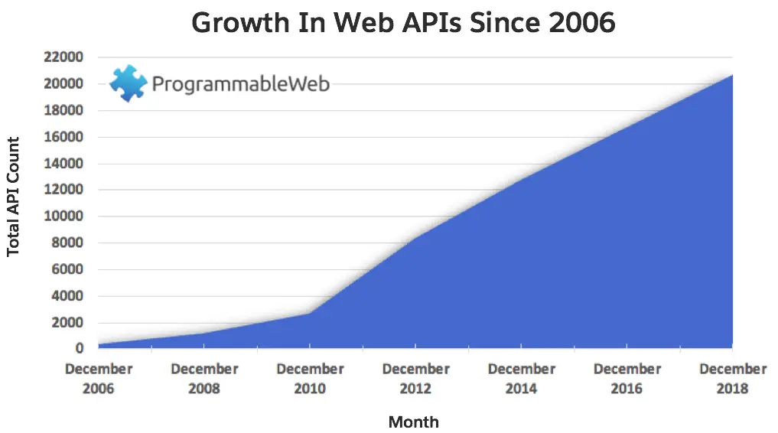









Web Service Economy
Web services allow companies and citizen developers to build innovative products
https://github.com/public-apis/public-apis - A massive list of public WEB APIs

Slide 5
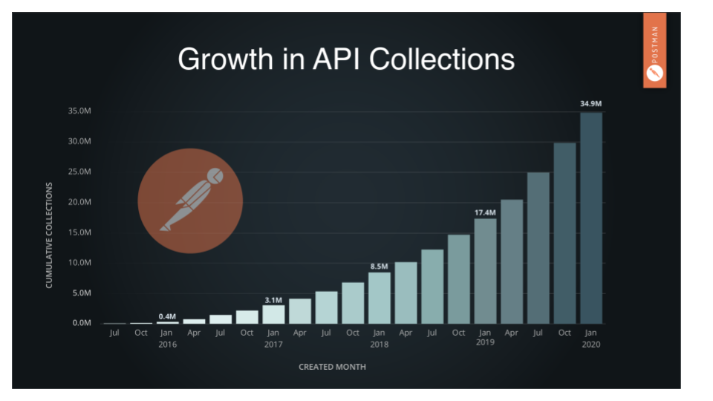
APIs used within Postman

Slide 6
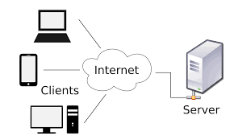
Client-Server Architecture

Slide 7
What is a Web Service?
KNOW THIS FOR INTERVIEWS!!!
A web service is any piece of software (known as a service provider) that makes itself available over the internet for client applications (known as service consumers) to consume them.
Clients ‘consume’ web services
Application A (consumer)
Application D (provider)
Application B (consumer)
HTTP Request
JSON
database
Application C (consumer)
HTTP Response
A web service provider application exposes the service to clients through an API - Application Programming Interface. An API defines the communication protocol and data exchange format that clients can use to access the service and exchange data.

Slide 8
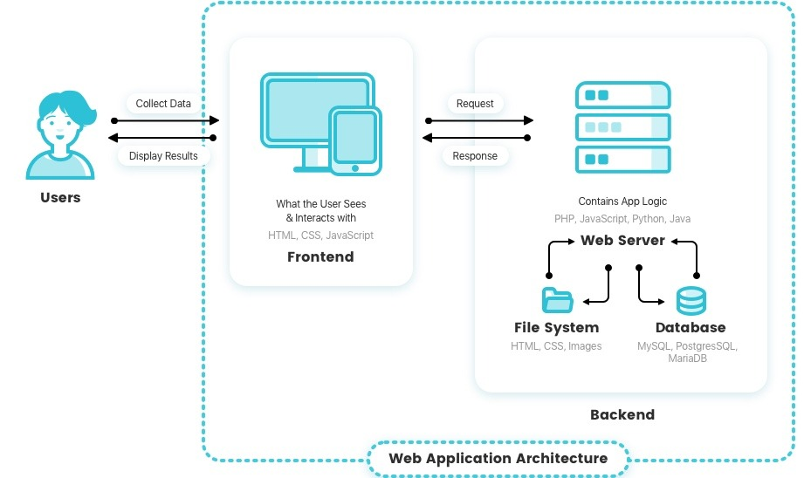

Sample Web Service Architecture
Request/Response (JSON)
Or another application (like your CLI program)

Slide 9
Today, we will learn how to consume a REST web service. (Where we are the client) But before we do that….

Slide 10
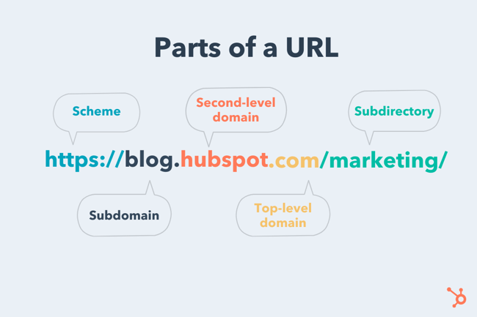
URL Structure

Slide 11
URL Structure
Application context path
https://api.example.com:5454/hr_app?fname=steve&lname=carmichael
Variable: fname
Value: steve
Variable: lname
Value: carmichael

Slide 12
A Few Other Common Protocols
Transmission Control Protocol (TCP): TCP is a popular communication protocol which is used for communicating over a network. It divides any message into series of packets that are sent from source to destination and there it gets reassembled at the destination.
Internet Protocol (IP): IP is designed explicitly as addressing protocol. It is mostly used with TCP. The IP addresses in packets help in routing them through different nodes in a network until it reaches the destination system. TCP/IP is the most popular protocol connecting the networks.
User Datagram Protocol (UDP): UDP is a substitute communication protocol to Transmission Control Protocol implemented primarily for creating loss-tolerating and low-latency linking between different applications.
Post office Protocol (POP): POP3 is designed for receiving incoming E-mails.
Simple mail transport Protocol (SMTP): SMTP is designed to send and distribute outgoing E-Mail.
File Transfer Protocol (FTP): FTP allows users to transfer files from one machine to another. Types of files may include program files, multimedia files, text files, and documents, etc.

Slide 13
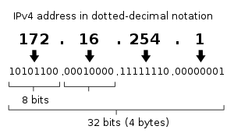
IP Address (v4)
An Internet Protocol address (IP address) is a numerical label assigned to each device connected to a computer network. An IP address serves two principal functions. It identifies the host and it provides the location of the host in the network, and thus the capability of establishing a path to that host
Values in each ‘octet’ can range from 0-255 (eg byte). Your local machine has an IP address of 127.0.0.1 (loopback IP). This is what you use in the URL when you are running a server on your own machine (eg during development).

Slide 14
Domain Name
A domain name is your website name. A domain name is the address where Internet users can access your website. A domain name is used for finding and identifying computers on the Internet because remembering IP Address is difficult.
Ex: techelevator.com, google.com, youtube.com
198.185.159.144
172.217.10.14
172.217.11.46

Slide 15
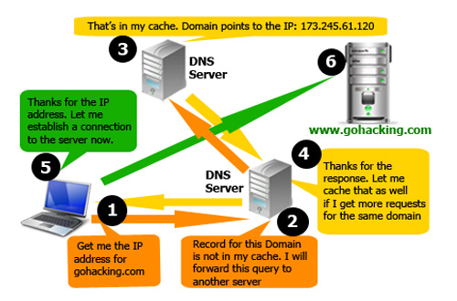
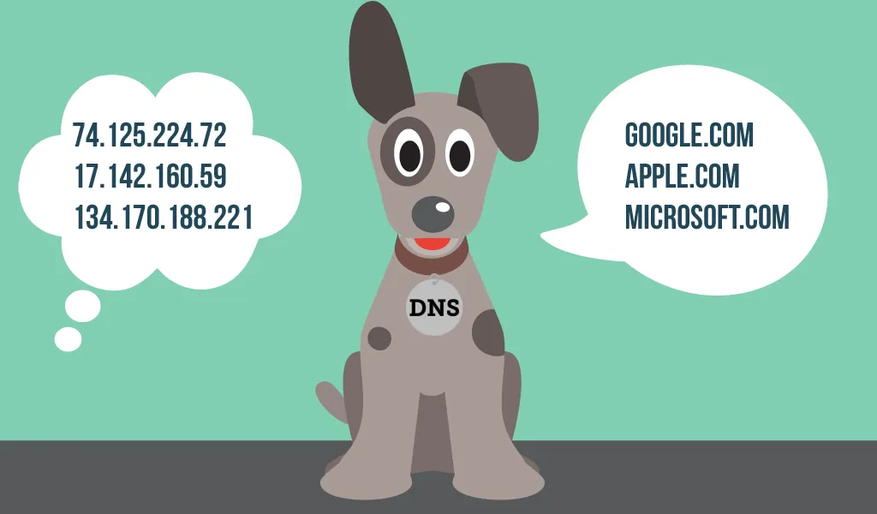
DNS - Domain Name System
The Domain Name System (DNS) is a distributed directory that resolves human-readable hostnames, such as www.techelevator.com, into machine-readable IP addresses like 50.16.85.103.

Slide 16
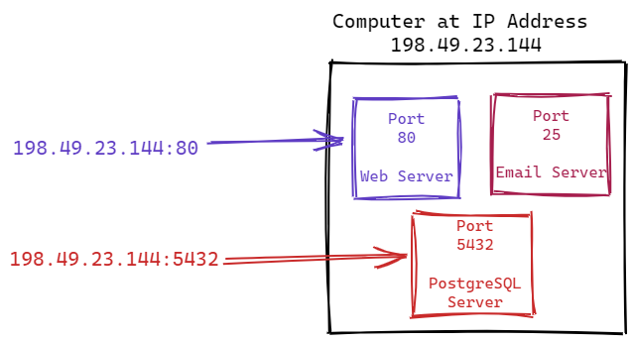
Port
There can be multiple software servers running on a single computer. Port numbers are used to identify which server application should handle the request.
IP Address is like the street address of a building, and the port number would be equivalent to an apartment number in that building.
The Port is added after the IP Address separated by a colon: 198.49.23.144:56
Port numbers range from 0-65535. Ports in the 0-1023 range are referred to as well-known ports and designated for specific uses.
Common well-known ports: Port 80 - HTTP Port 443 - HTTPS Port 25 - SMTP (Email Mail) Port 21 - FTP (File Transfer) Port 22 - SSH (Secure remote terminal)

Slide 17
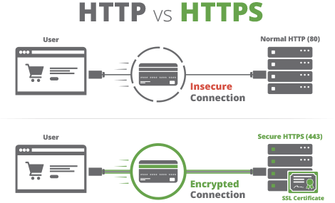
HTTP vs HTTPS
HTTP stands for Hyper Text Transfer Protocol
HTTPS stands for Hyper Text Transfer Protocol Secure

Slide 18
HTTP Methods
GET
The GET method requests a representation of the specified resource. Requests using GET should only retrieve data.
POST
The POST method is used to submit an entity to the specified resource, often causing a change in state or side effects on the server.
PUT
The PUT method replaces all current representations of the target resource with the request payload.
DELETE
The DELETE method deletes the specified resource.
TODAY WE FOCUS ON GET Read more about GET and other methods at: https://developer.mozilla.org/en-US/docs/Web/HTTP/Methods

Slide 19
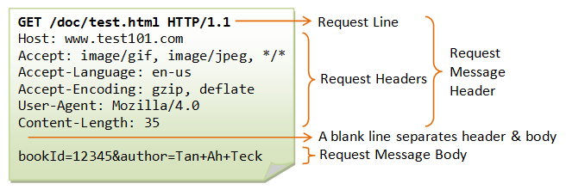
HTTP GET has the following packet structure
http://test101.com/doc/test.html?bookId=12345&author=Tan+Ah+Teck
Everything after the ? is known as a querystring (used in web page requests). These are parameters you are sending to the server (search filters, etc). REST is similar but not exact

Slide 20
RESTful Web Services
REST stands for REpresentational State Transfer.
REST is web based architecture that uses HTTP Protocol.
It revolves around resource where every component is a resource and a resource is accessed by a common interface using HTTP standard methods.
RESTful services are:
Uniform interface driven based on resources
Stateless
Client/Server based
Layered (Data, Logic, Interface)

Slide 21
Rest Service Resource
We want to fetch this resource
GET http://someURL.com:8080/students
Client
Service Provider
Instead of HTML, we return JSON
{"students":[
{"name":"John", "age":"23"},
{"name":"Steve", "age":"28"},
{"name":"Peter", "age":"32”},
{"name":"Chaitanya", "age":"28"}
]}
A resource in REST is a similar Object in Object Oriented Programming or is like an Entity in a Database. It is the entity/data we need the service to use or return

Slide 22
JSON
JSON (JavaScript Object Notation) is a lightweight data-interchange format. It is easy for humans to read and write. It is easy for machines to parse and generate
{
"fruit": "Apple",
"size": "Large",
"color": "Red"
}
{"students":[
{"name":"John", "age":"23"},
{"name":"Steve", "age":"28"},
{"name":"Peter", "age":"32”},
{"name":"Chaitanya", "age":"28"}
]}
JSON uses key/value pairs
JSON object ‘students’, has an array of key/value pairs

Slide 23

Postman Utility Tool (Client Tool)
Postman is a simple utility tool that allows us to work with HTTP. We can use it to test web services without having to code a client application.
Open Postman from your system tray at the bottom of your screen.

Slide 24
Postman Demo
http://localhost:3000/
JSON HTTP Server
Client Software
Server Software

Slide 25
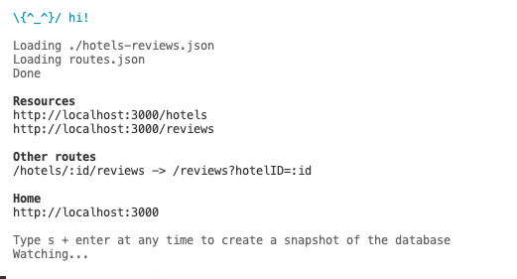
Start the server
In Git Bash, navigate to your 11_Consuming_RESTful_APIs_Part_1 folder.
cd into the server directory located at: lecture/server
Do an ls and you should see several files ending in .json
Run npm install
Run npm start
The console looks like this:

Slide 26
Java Lecture Code
http://localhost:3000/
Java CLI Program
JSON HTTP Server
Client Software
Server Software

Slide 27
Calling a Web Service Using Java
Spring Boot is an open source Java-based framework used to create Web Services. It abstracts much of the repetitive and tedious work needed to create or use a Web Service, much like how SpringJDBC is abstracts JDBC.
Spring Boot provides the RestTemplate, which is a Java based client for calling RESTful Web Services.
Endpoint - an endpoint is URL that points to a Web Service. To access a web service with RestTemplate, we must provide it the API’s endpoint: http://localhost:3000/
String response = restTemplate.getForObject(endpointUrl, String.class);
getForObject() - method that retrieves a JSON response and converts it to an object.
String response - Variable to hold the response.
endpointUrl - the URL of the endpoint to make the request.
String.class - The Data Type of the Object to return. This should match the variable that will hold it.

Slide 28
JSON with Java Objects
The RestTemplate getForObject() method can automatically populate a Java Object from the JSON. The Java Object must have member variables for the JSON properties we want mapped. The data type and name must match!
Getters and Setters must exist for each member variable the RestTemplate will populate, and there must be a no-argument constructor for the class.
Not all properties need to exist in the Java object. The Java Object can include a subset of the properties.
[
{
"id": 1,
"name": "Greektown Detroit",
"stars": 4, “roomsAvailable": 75, "coverImage": "greektown-detroit.webp"
}
]
public class Hotel {
private int id;
private String name;
private int stars;
private int roomsAvailable;
private String coverImage; … getters/setters …
}

Slide 29
Parameters in Endpoints
A Path Parameter (Variable) is one that is passed as part of the resource path in the URL.
http://localhost:3000/hotels/4/reservations?name=smith
A Query String Parameter is one that is passed as a key/value pair as part of the Query portion (called the Query String) of the URL.
http://localhost:3000/hotels?stars=3

